Slide 1
Presentation On
Dialogue System
Prepared By
Chandra Shekhar
078MSIISE04

Slide 2
Outlines
Basic Dialogue System
Component of dialogue system
Diagram of Dialogue system
Detail of Component of dialogue system
Types of Dialogue System
Automatic Speech Recognition
Text to speech
References

Slide 3
Basic Dialogue System[1]
A Dialogue is a conversation between two or more agents, be they human or machine.
It is also Called as Conversation System.
Dialogue System, a computerized system whose aim is to interact with humans in a natural language.
A dialogue system is a computer program that communicates with a human user in a natural Way.
The dialogue System provides an interface between the user and a computer-based application that permits interaction

Slide 4
Basic Dialogue System [2]
Today dialogue system is developing in text, graphical, spoken and multimodal systems.
A text based dialogue system is in which we chat with the system.
A spoken dialogue systems is defined as a computer systems that human interact on a turn-by-turn basic and in which spoken natural language interface plays an important part in
the communication .
A multimodal dialogue systems are those which are dialogue systems that process two or more combined user input modes - such as speech, pen, touch, manual gestures, gaze,
and head and body movements.

Slide 5
Basic Dialogue System [3]
Different Dialogue Systems have different architectures .
But All of the Dialogue system has same phase Following are the phase passes through the
Dialogue System.
Input
Recognition
Natural Language Understanding
Dialogue Management
Response Generation
Output Renderer

Slide 6
Component of Dialogue System
A Dialogue system has mainly seven components.
These components are following:
Input Decoder
Natural Language Understanding
Dialogue Manager
Domain Specific Component
Response Generator
Output Renderer

Slide 7
Diagram of dialogue System
Input Decode
Output Render
Language Understanding
Response Generator
Dialogue Manner
Domain Specific Component

Slide 8
Component Of Dialogue System[1]
Input Decoder
It converts the input to the simple text.
This component involves conversion of spoken sound (user utterances) to text (a string of words).
This requires the knowledge of phonetics and phonology.
For this purpose speech Recognition is needed.
There are many systems available for this purpose. These are called Automatic Speech Recognition (ASR), Computer Speech Recognition or simply Speech to Text (STT).
ASR will explain latter

Slide 9
Component Of Dialogue System[2]
Natural Language Understanding
As the name suggest this unit try to understand what user want to tell.
It converts the sequence of words into a semantic representation that can be used by the dialogue manager.
Semantics involves the deconstruction of words, signals, and sentence structure
This component involves use of morphology, syntax and semantics.
Morphology is the study of the structure and content of word forms.

Slide 10
Component Of Dialogue System[3]
Dialogue Manager
The Dialogue Manager manages all aspects of the dialogue.
It takes a semantic representation of the user’s text, figures out how text fits in the overall
Context.
It performs many tasks these are:
Maintains the history of dialogue
Adopts certain dialogue strategies
Deal with malformed and unrecognized text
Decides the best response for user.

Slide 11
Component Of Dialogue System[4]
Domain Specific Component
The Dialogue Manager usually needs to interface with some external software such as a
database or an expert system.
The query or plans thus have to be converted from the internal representation used by the dialogue manager to the format used by the external domain specific system.
This interfacing is handled by the domain specific components.
This can be handled by Natural Language Query Processing system.
This system generate SQL query from natural language.

Slide 12
Component Of Dialogue System[5]
Response Generator
This component involves constructing the message that is to be given by the user.
It takes decision regarding what information should be included, how information should be structured.
It provides us choice of words and syntactic structure for message.
Current systems use simple methods such as insertion of retrieved data into predefined slots in a template.

Slide 13
Component Of Dialogue System[6]
Speech Generation
It translates the message constructed by the response generation component into spoken form.
For speech generation two approaches may be used.
The first approach is to use prerecorded canned speech may be used with spaces to be filled by retrieved or previously recorded samples.
Another approach is use text to speech synthesis.
In this speech is generated of text.
It is called Contaminative Speech Synthesis, Text to Phoneme conversion and Phoneme to speech conversion or Text to Speech (TTS)

Slide 14
Classification of Dialogue System[1]
On the basis of method use to control dialogue a dialogue system can be classified in three
categories:
Finite State (or graph) based systems
Frame based systems
Agent based systems

Slide 15
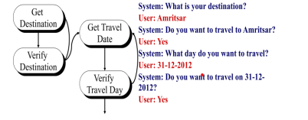
Classification of Dialogue System[1]
Finite State based Systems
In these types of systems the user is taken through a dialogue consisting of a sequence of
predetermined steps or stages.
The flow of dialogue is specified as a set of dialogue states.

Slide 16
Advantage and Disadvantage of Finite Based System
Advantages
Simple to construct
The required vocabulary and grammar for each state can be determined in advance.
Disadvantages
Dialogues are not natural
Do not allow over-informative answers
Inhabits the user ability to ask questions and take initiative.

Slide 17
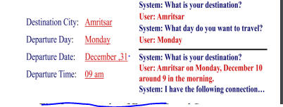
Classification of Dialogue System[3]
Frame Based Systems
Frame Based systems uses template filling from user response
In this system user is asked questions that enable the system to fill slots in a template in order to perform tasks.
The flow of dialogue is not predetermined but depends upon the content of user input and the information the user has to elicit.
17

Slide 18
Classification of Dialogue System[4]
Advantage and Disadvantage of Frame Based System
Advantages
Allow more natural Dialogues
User can provide over informative answers
Disadvantages
These systems can’t handle complex dialogues
Range of application is limited to the systems that elicit information from users and act on
the basis on the same.

Slide 19
Classification of Dialogue System[5]
Agent Based Systems
These systems allow complex communication between the system.
The user and the application in order to solve some problem or task.
The interaction is viewed as interaction between two agents, each of which is capable of reasoning .
Its has own actions and beliefs.
The dialogue model takes the preceding context into account.
The dialogue evolves dynamically as a sequence of related steps that build on top of each other

Slide 20
Classification of Dialogue System[6]
Advantage and Disadvantage of Agent Based System
Advantages
Allow natural language in complex domain
User friendly, like talking to human
Disadvantages
These systems are hard to build
The agent itself are usually very complex

Slide 21
Automatic Speech Recognition[1]
Automatic Speech Recognition or ASR, as it’s known in short.
It is the technology that allows human beings to use their voices to speak with a computer interface in a way that, in its most sophisticated variations, resembles normal human conversation.
Speech Recognition is a subfield of computational linguistics dealing with the recognition and translation of spoken language into text by computers, a process known as “speech to text” .
It is used in the form of intelligent smart phone interfaces like the Siri program on the iPhone and other systems used in business and advanced technology contexts.

Slide 22
Working of Automatic Speech Recognition work.
We speak to the software via an audio feed
The device we are speaking to creates a wave file of your words
The wave file is cleaned by removing background noise and normalizing volume
The resulting filtered wave form is then broken down into what are called phonemes.
Each phoneme is like a chain link and by analyzing them in sequence, starting from the first phoneme, the ASR software uses statistical probability analysis to deduce whole words and then from there, complete sentences

Slide 23
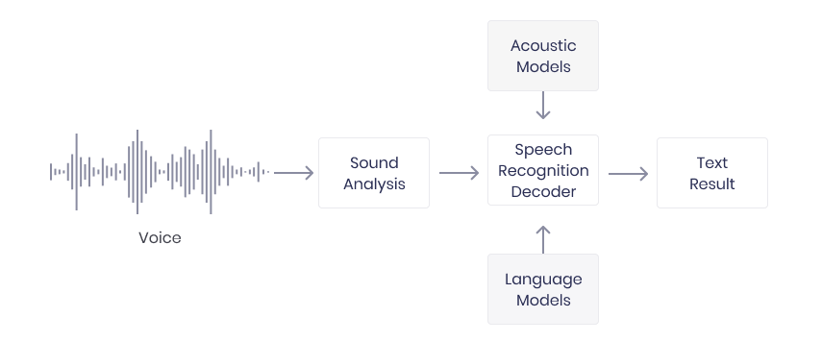
Block Diagram of Automatic Speech Recognition work

Slide 24
Text to Speech [1]
Text-to-speech (TTS) is a type of assistive technology that reads digital text aloud.
Text To Speech Conversion Using NLP means converting text to the voice speech using NLP.
NLP is a field of artificial intelligence that gives the machines the ability to read, understand, and derive meaning from human languages.
With a click of a button or the touch of a finger, TTS can take words on a computer or other digital device and convert them into audio.

Slide 25
Text to Speech [2]
The text-to-speech (TTS) synthesis procedure consists of two main phases.
The first is text analysis, where the input text is transcribed into a phonetic or some other linguistic representation.
It converts raw text containing symbols like numbers and abbreviations into the equivalent of written-out words.
This process is often called text normalization, pre-processing, or tokenization.

Slide 26
Text to Speech [3]
The second one is the generation of speech waveforms, where the output is produced from this phonetic and prosodic information.
It often referred to as the synthesizer — then converts the symbolic linguistic representation into sound.
It also referred as Back end Part.

Slide 27
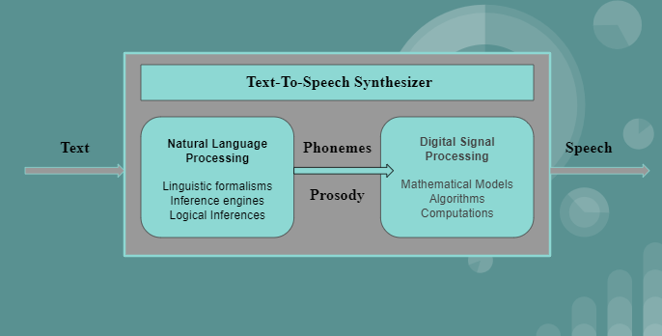
Structure of A Text-To-Speech Synthesizer System

Slide 28
References
Arora, S., Batra, K. and Singh, S. (n.d.). Dialogue System: A Brief Review. [online] Available at: https://arxiv.org/ftp/arxiv/papers/1306/1306.4134.pdf.
LINGAYAT, T. (2021). Text to Speech using Natural Language Processing. [online] Medium. Available at: https://tulshidas-lingayat17.medium.com/text-to-speech-using-natural-language-processing-b19fabe9db73 [Accessed 25 Sep. 2022].
Analytics Vidhya. (2022). A Comprehensive Overview on Automatic Speech Recognition (ASR). [online] Available at: https://www.analyticsvidhya.com/blog/2022/03/a-comprehensive-overview-on-automatic-speech-recognition-asr/.
mbhs.edu. (n.d.). Human-Computer Dialogue Systems | Natural Language Processing. [online] Available at: https://mbhs.edu/~lpiper/darn-nlp/dialogue [Accessed 25 Sep. 2022].

Slide 29
THANK YOU

